Slide 1

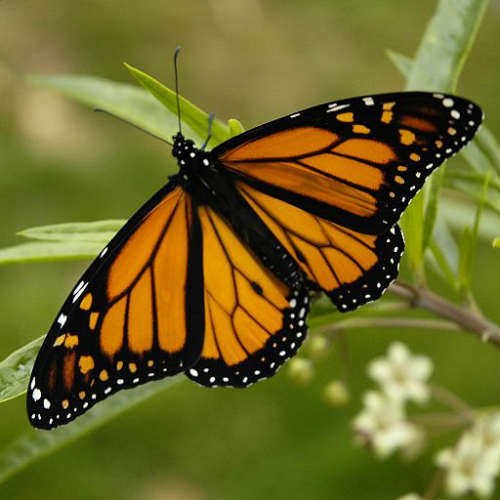

Spread Spectrum Image Watermarking
Team Members:
Manish Kumar: 2020ITB007
Adesh Kumar Maharaj: 2020ITB041
Ashesh Karan: 2020ITB056
Supervisor:
Prof. Santi Prasad Maity

Slide 2
Content
Introduction
Digital watermarking
Image watermarking and properties
Spread spectrum
Watermark Embedding
Watermark Extraction
Conclusion
References

Slide 3
Introduction
The rapid development of new Information Communication Technologies (ICT) has improved the ease of access to digital information.
Since digital data can be reproduced infinitely without any loss of quality, it is difficult to differentiate illegal copies from the original ones.
Digital signature, digital fingerprint, and digital watermarking are examples of digital signal processing to provide copyright owners with the required level of protection

Slide 4
Digital watermarking?
Visible
Invisible

Slide 5
Digital Watermarking
Watermark
Digital
Watermarking
Watermarked Data
Data

Slide 6

Visible Watermarking
Visible watermarking is the process of embedding data (watermark) into a multimedia object (video/image) such that the embedded watermark is perceptible to a human observer.

Slide 7

Invisible Watermarking
Invisible digital watermarking (IDW) is a type of steganography that aims at concealing information in a medium to prove ownership, integrity or provide additional information.
We will see more about this in upcoming slides.

Slide 8
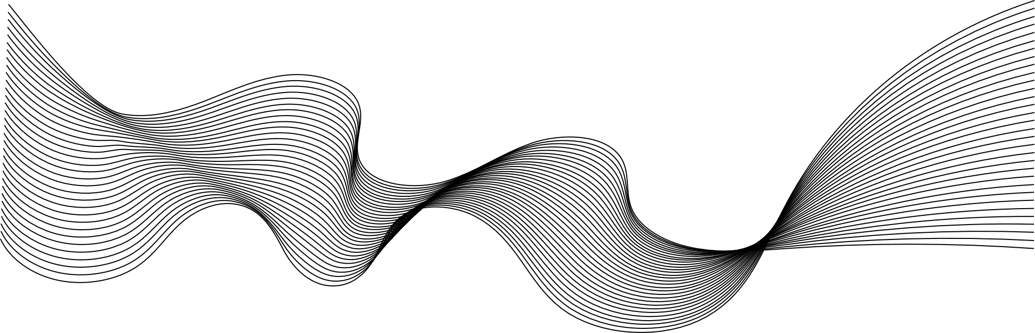
Image Watermarking
Image watermarking is embedded text or logos over a digital image.
This watermark graphic or text indicates ownership or copyright of the image.

Slide 9
Properties
Should be perceptually invisible to prevent obstruction of the original image.
Statistically invisible so it cannot be detected or erased.
Simple to extract watermark from image
Should be robust to filtering, additive noise, compression, and other forms of image manipulation.
Should be able to determine the true owner of the image.

Slide 10
Spread Spectrum
Spread spectrum system is one in which the transmitted signal is spread over a wide frequency band.
The codes used for spreading have low cross correlation values and are unique to every user.
Advantages of spread spectrum communication:
Resist intentional and intentional interference.
Can share the same frequency band with other users(multiple watermark).
Protect the privacy, due to the pseudo random code sequence.

Slide 11
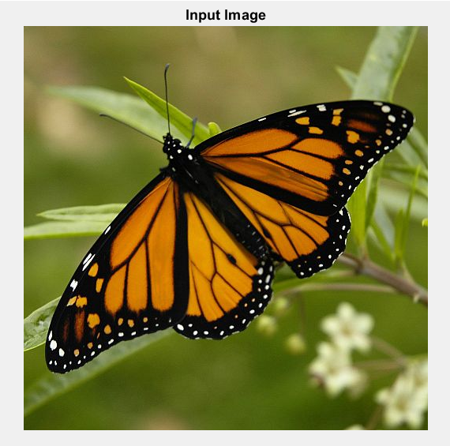
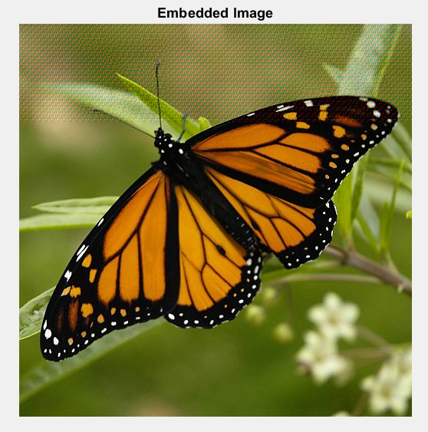
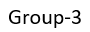
Watermark Embedding
Watermark
+
=

Slide 12
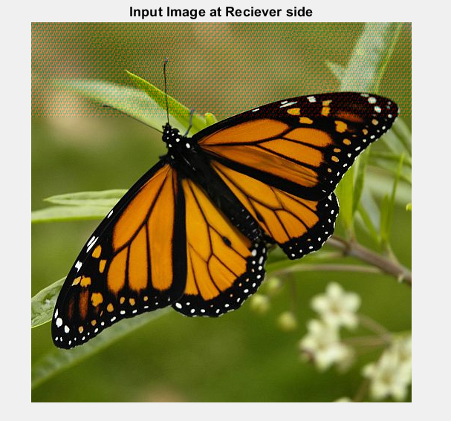
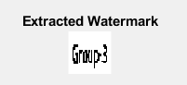
Watermark Extraction
Extraction

Slide 13
Conclusion
Watermarking has been for quite a while in the field of security in distributable digital date
Crypto mechanics can be used as additional security layer in digital watermarking, which combines the effictiveness of the approach.
These when incorporated into a single procedure, will prove to be a robust and healthy approach in resisting any types of attacks.

Slide 14
Reference
R.Pickholtz, D.Schilling, L.Millstein: “Theory of spread spectrum communications: a tutorial”, IEEE Transactions on Communications, Vol.30, 1982.
A. B. Watson, G. Y. Yang, J. A. Solomon, J. Villasenor, “Visibility of Wavelet Quantization Noise”, IEEE Transaction on Image Processing vol. 6, August 1997.
S.P.Maity, A.Banerjee, and M.K.Kundu, “VLSI Design of Spread Spectrum Image Watermarking”, 13th-National Conference on Communications January 26-28, 2007, page No. 251-257.

Slide 15
Thank You

